Slide 1
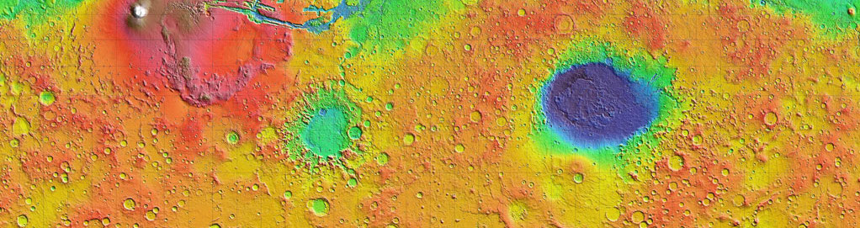


Seasonal Temperature Variations and CO₂ Sublimation Activity Near the Martian South Pole
Paras Angell and Phil Christensen
School of Earth and Space Exploration,
Arizona State University

Slide 2
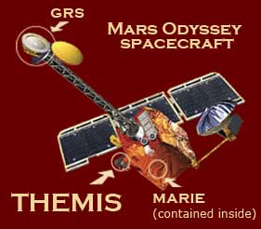
The South Pole of Mars
Seasonal layer of CO₂ ice
Seasons on Mars measured in Solar Longitude
CO₂ ice sublimates in spring and summer
Visible Images
Thermal Infrared Images
South Polar ice cap, NASA.gov
THEMIS camera onboard NASA’s Mars Odyssey spacecraft

Slide 3
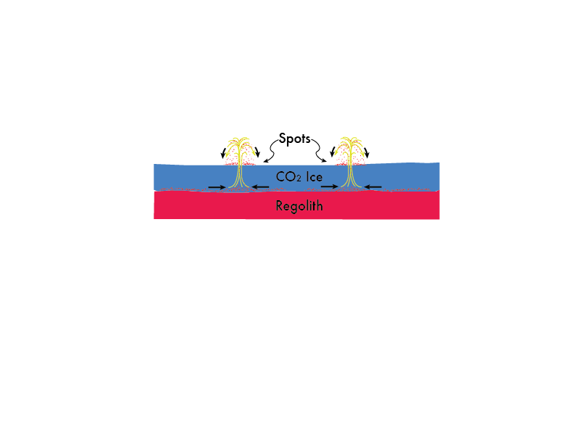
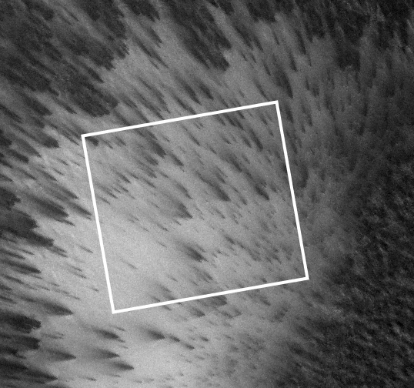
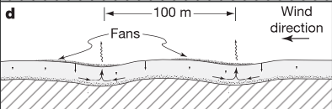
How Do Spots and Streaks Form?
Ice layer is on top of regolith
Sublimation occurs from bottom of CO₂ ice layer
Dark spots and streaks
Pressure builds
CO₂ gas jets erupt spewing dust
Dust deposited on surface
Basal sublimation model, (Kieffer, Christensen, Titus 2006)

Slide 4
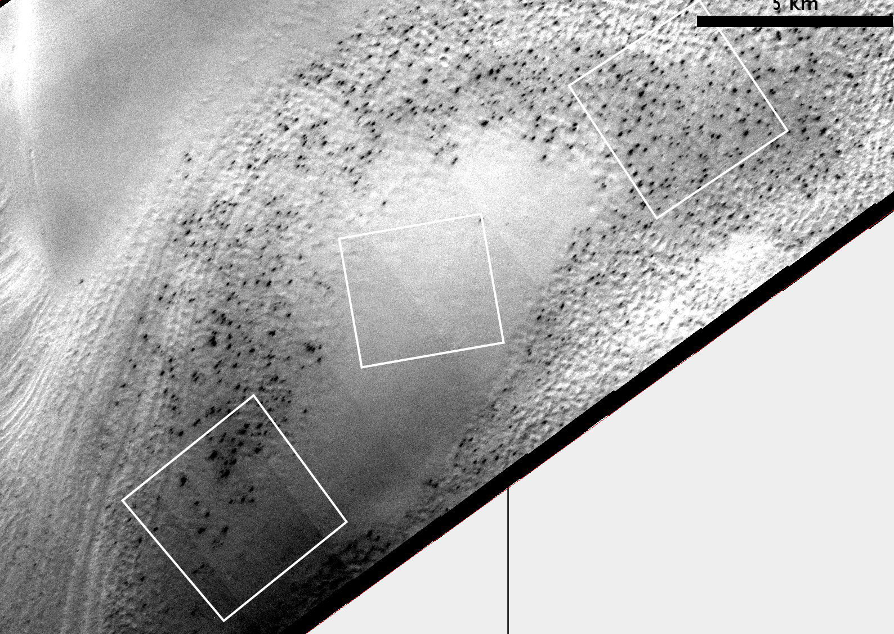
THEMIS Visible Images
Area of Study: 86°S/99°E
4 km x 4 km regions
Visible image in early spring (Ls 175°)
Regions A2 & A3 have many dark spots
A1 dark spots have yet to form
137 K
A₁
A₃
138 K
A₂
138 K
N
CO₂ ice-covered surface near the South Pole of Mars at Ls = 174.8°
Notes:
Figure 1: CO₂ ice-covered surface near the South Pole of Mars. Visible THEMIS Image at solar longitude (Ls) 174.8°, early spring, of a region centered near 99°E and 86°S at 18 m per pixel

Slide 5
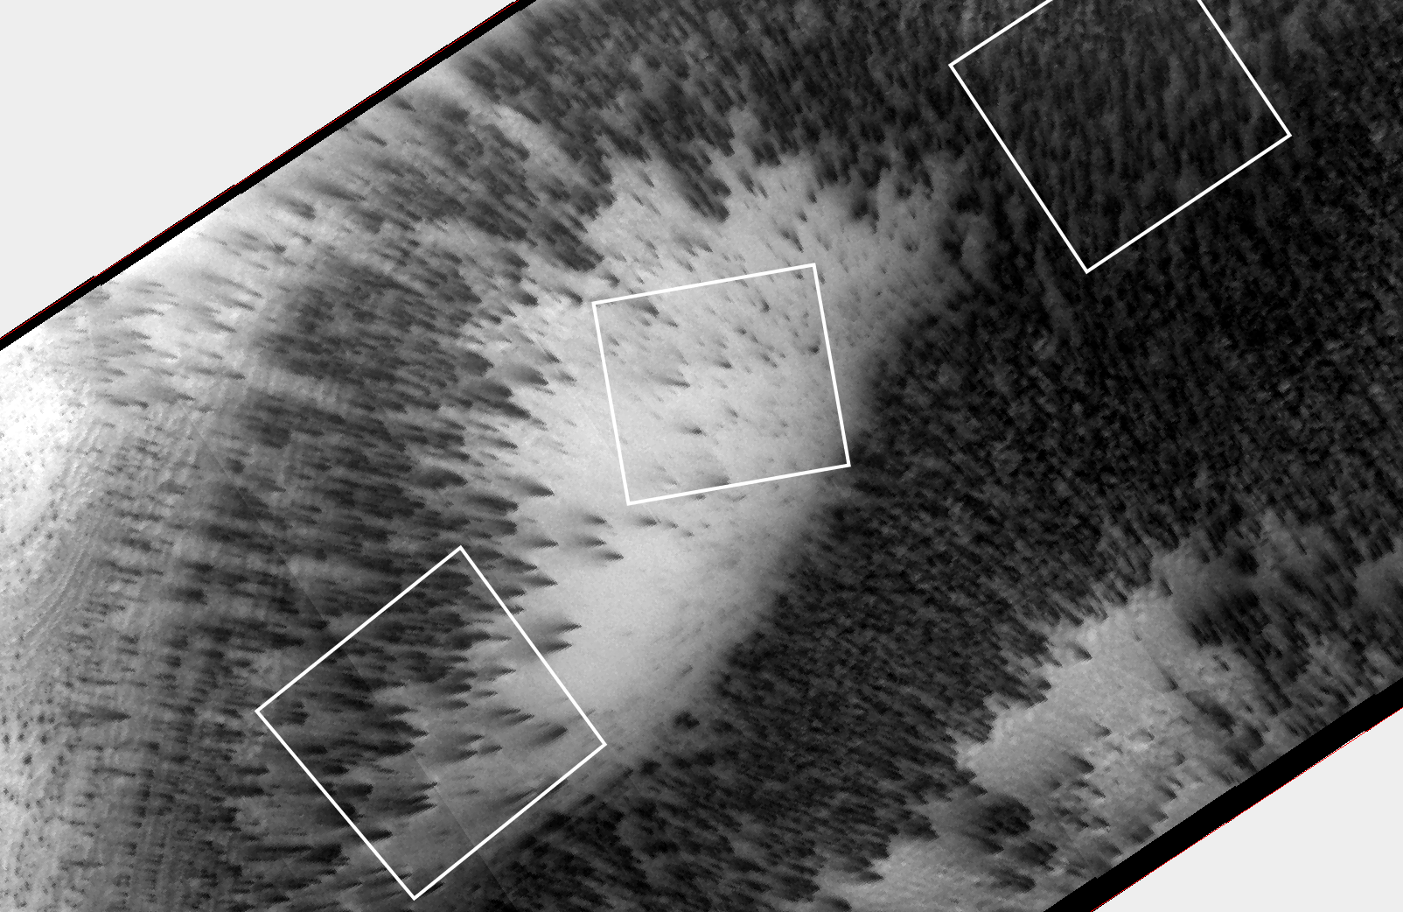
Progression of CO₂ Sublimation
Sublimation of CO₂ ice in full swing
A1 and A2 have dark streaks oriented NW
A3 covered with dark material
Temperatures have warmed up to ~160K
158 K
N
A₁
A₃
158 K
A₂
160 K
Effects of CO₂ gas jets and deposition 71 sols later at Ls 213°
Notes:
Figure 2: Effects of CO₂ gas jets and deposition 71 sols later (early summer). Visible THEMIS Image of the same region at Ls 213°.

Slide 6
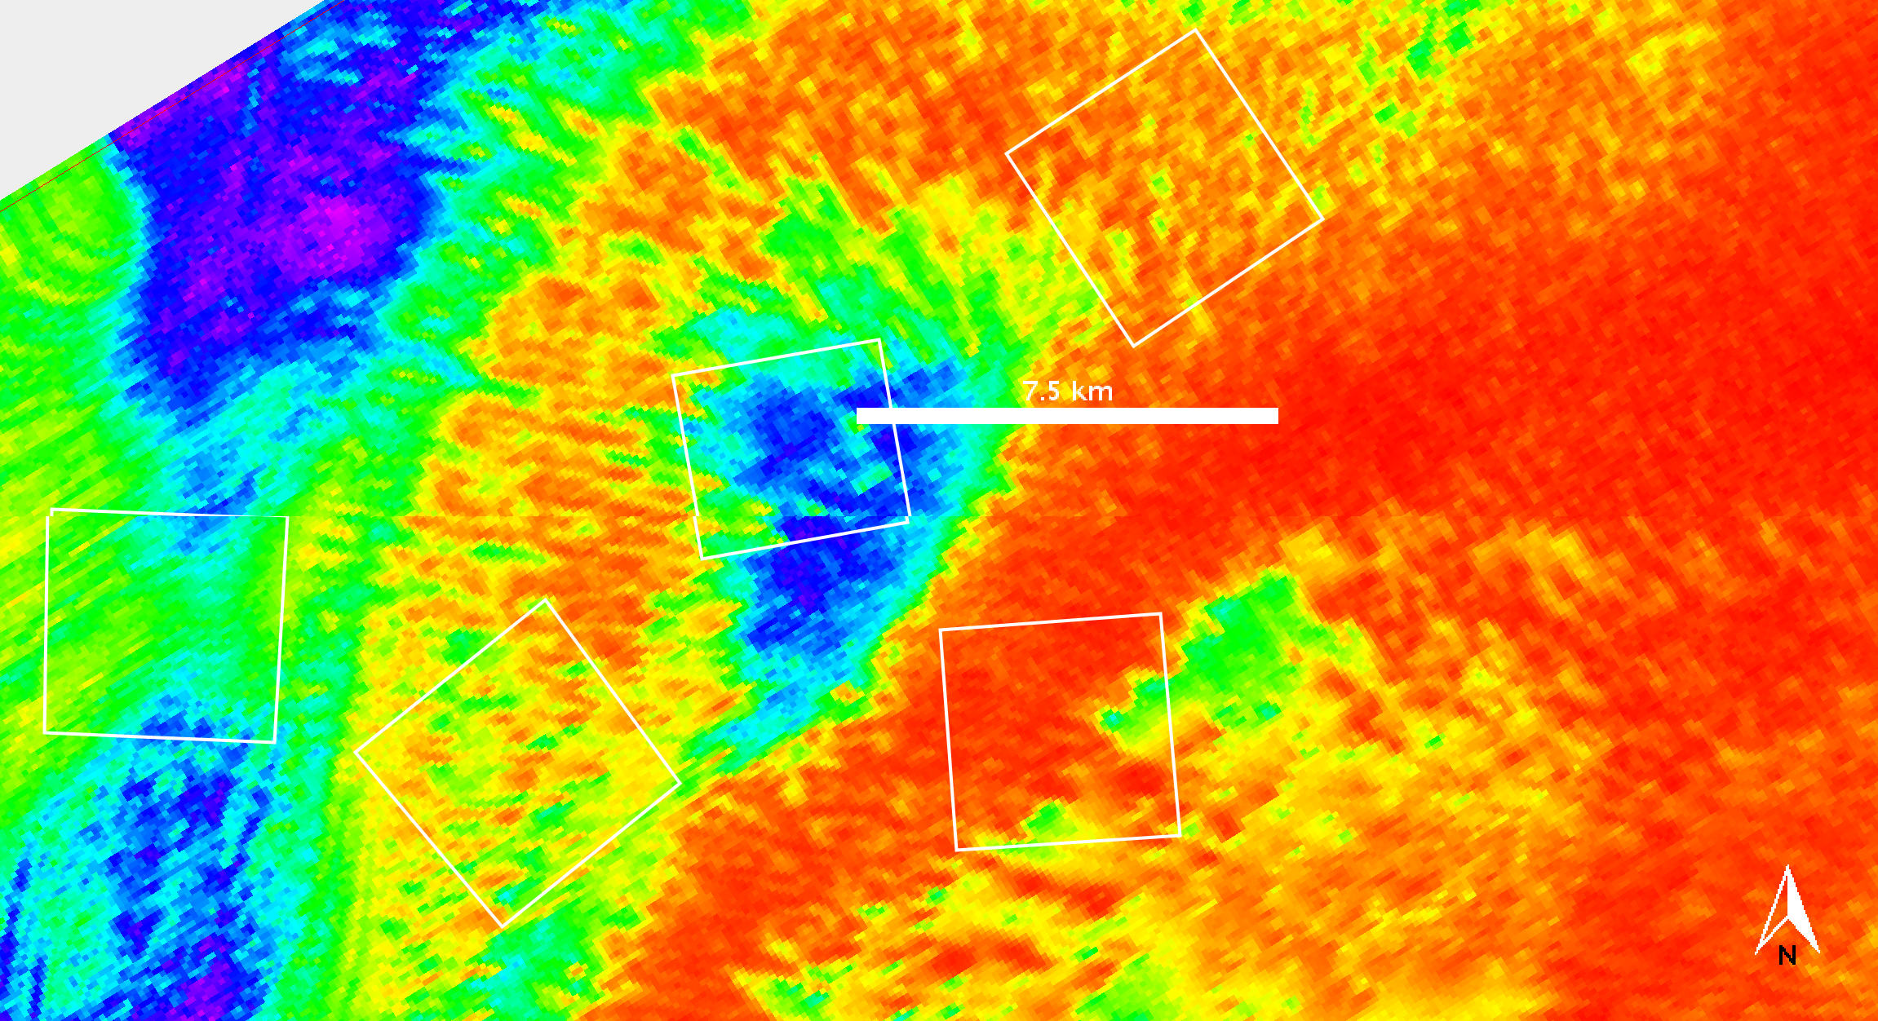
Thermal
Infrared Studies
THEMIS Thermal Infrared Image
Average temperatures calculated using JMARS software
Area A1 is colder than A2 and A3
170K
180K
190K
200K
210K
220K
230K
Temperature
THEMIS Infrared Image (false-color) at Ls 257°
Notes:
Figure 3: Infrared THEMIS Image (false-color) at Ls 257° for Mars year 31, for the region centered near 99°E and 86°S at 100 m per pixel. The colors represent temperatures.

Slide 7
Seasonal Temperature Variations
Temperature gradually increases from Ls 170° to 250°
Sharp increase at Ls 250°
Maximum temperature ~245K
Average Surface Temperatures for Areas A1, A2, A3 as a function of Ls for Mars Year 31.
Notes:
Figure 3: Average Surface Temperatures for Areas A1, A2, A3 as a function of Ls for Mars Year 31

Slide 8
Year-to-Year Variability
Average temperatures for area A1 for Mars years 31, 32, and 33
Sharp increase at Ls 250° is repeatable from year to year
Surface cools off ~Ls 300°
Average Temperatures vs. Ls for Area A1 for Mars Years 31, 32, and 33.
Notes:
Figure 5: Avg. Temperatures vs. Ls for Area A1 for Years 31, 32, and 33.

Slide 9
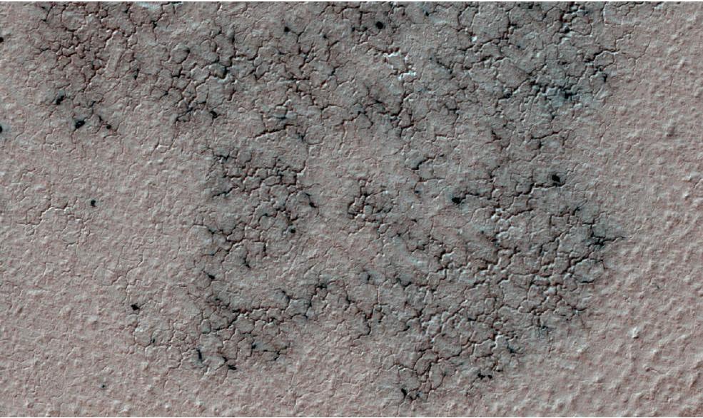
Conclusions
♂ Surface temperatures increase gradually from 140 K to 160 K during the spring season (Ls 170° - 245°).
♂ The rapid increase in temperature corresponding to sublimation of CO₂ ice happens at the end of spring (Ls 250° – 270°).
♂ The maximum surface temperatures of ~ 245K correspond to the temperature of the defrosted terrain.
Image Credit: Hansen, C.J. et al. Icarus 205 (2010) 283–295

Slide 10
Acknowledgments
I would like to thank NASA Space Grant and NASA for this amazing opportunity to conduct research.
My mentor, Prof. Phil Christensen for inspiration and guidance.
Members of the JMARS team for help with image processing.
Prof. Tom Sharp for leading the ASU/NASA Space Grant Program.
Ms. Desiree Crawl for organizing and coordinating this program.

